Slide 1
Taking advantage of .NET Aspire to build event-driven apps using CQRS
Santiago Arango Toro

Slide 2
Agenda
01
02
03
CQRS and Vertical Slicing
Hands-On! Integration with Service Bus
Hands-On! Integration with Cosmos DB + Redis
04
05
Hands-On! Integration with Signal R
Questions

Slide 3
What is CQRS?
01
02
03
04
Command
Query
Segregation
Responsibility

Slide 4
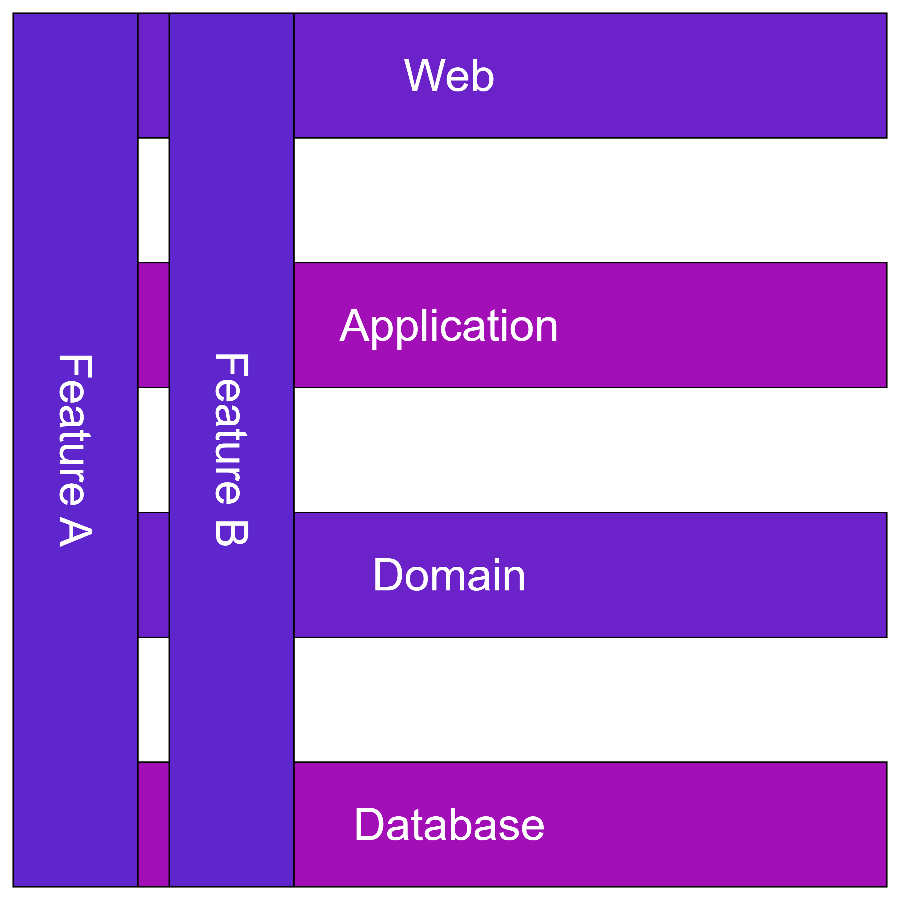
Vertical Slicing
One Slice at the time

Slide 5
Hands On!

Slide 6

Resources
https://learn.microsoft.com/en-us/azure/architecture/patterns/cqrs
CQRS Patter
https://learn.microsoft.com/en-us/dotnet/aspire/fundamentals/components-overview?tabs=dotnet-cli
.NET Aspire Components
https://github.com/nadirbad/VerticalSliceArchitecture
Vertical Slice Architecture example in .NET 8

Slide 7
.NET Aspire Developers Day
Start your learning journey:
aka.ms/dotnetAspireDevDay/Collection

